Slide 1
Machine Learning
李育名
amrmm1997@gmail.com
8/14/2020

Slide 2
Content
Logistic regression
Support vector machine
Bias-variance trade-off
Decision tree
Ensemble
– bagging: random forest
– boosting

Slide 3
Package
>>> pip install scikit-learn
>>> from sklearn import …
https://scikit-learn.org/stable/index.html

Slide 4
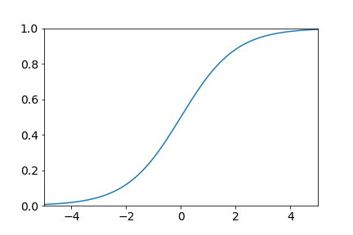
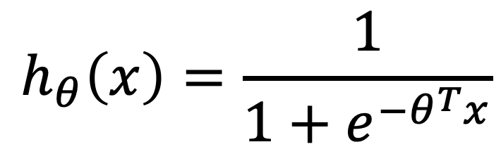
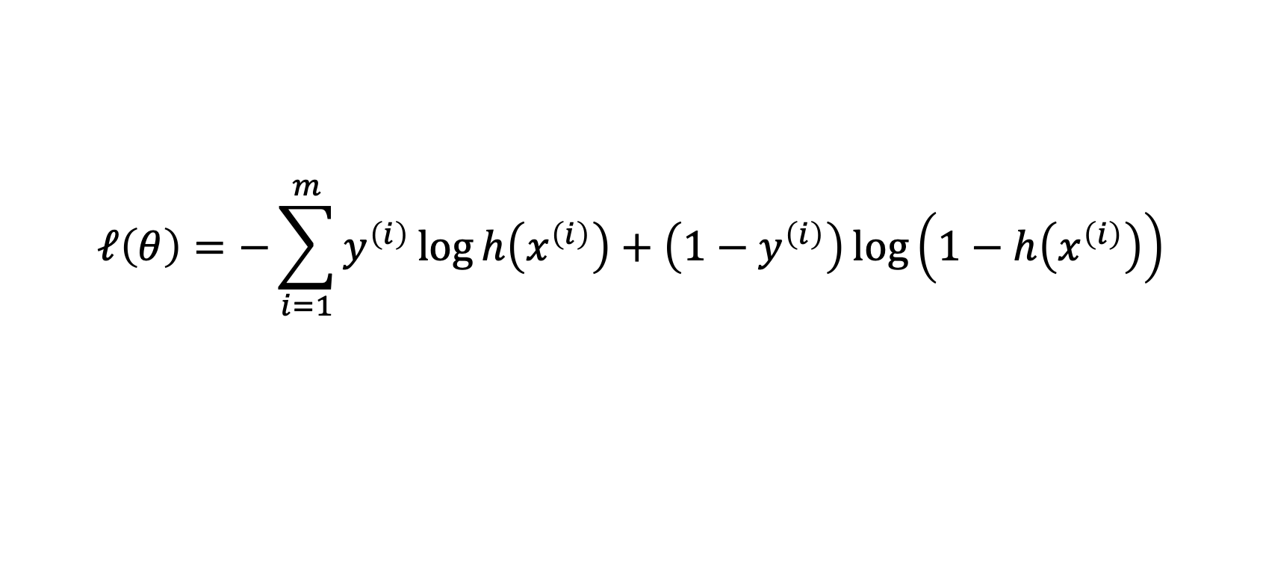
Logistic Regression
$$h_{θ}\left(x\right)=\frac{1}{1+e^{−θ^{T}x}}$$
$$ℓ\left(θ\right)=−\sum_{i=1}^{m}{y^{\left(i\right)}\log{h\left(x^{\left(i\right)}\right)}+\left(1−y^{\left(i\right)}\right)\log\left(1−h\left(x^{\left(i\right)}\right)\right)}$$

Slide 5
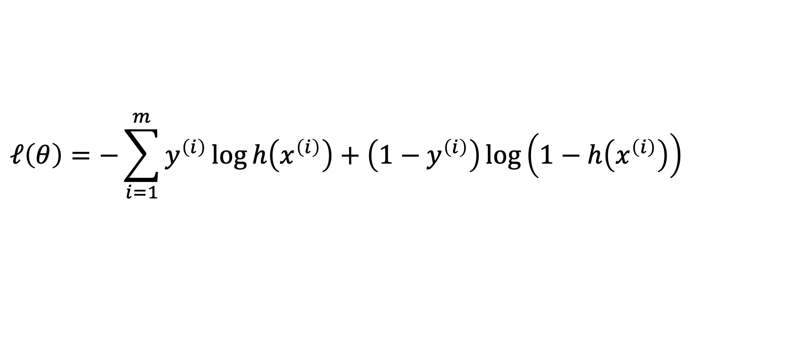
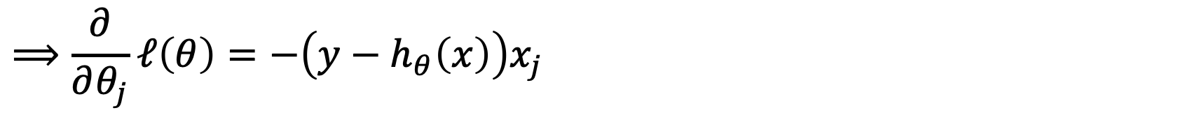
Logistic Regression
$$ℓ\left(θ\right)=−\sum_{i=1}^{m}{y^{\left(i\right)}\log{h\left(x^{\left(i\right)}\right)}+\left(1−y^{\left(i\right)}\right)\log\left(1−h\left(x^{\left(i\right)}\right)\right)}$$
$$⟹\frac{∂}{∂θ_{j}}ℓ\left(θ\right)=−\left(y−h_{θ}\left(x\right)\right)x_{j}$$
$$⟹θ_{j}:=θ_{j}−α\left(y^{\left(i\right)}−h_{θ}\left(x^{\left(i\right)}\right)\right)x_{j}^{\left(i\right)}$$

Slide 6
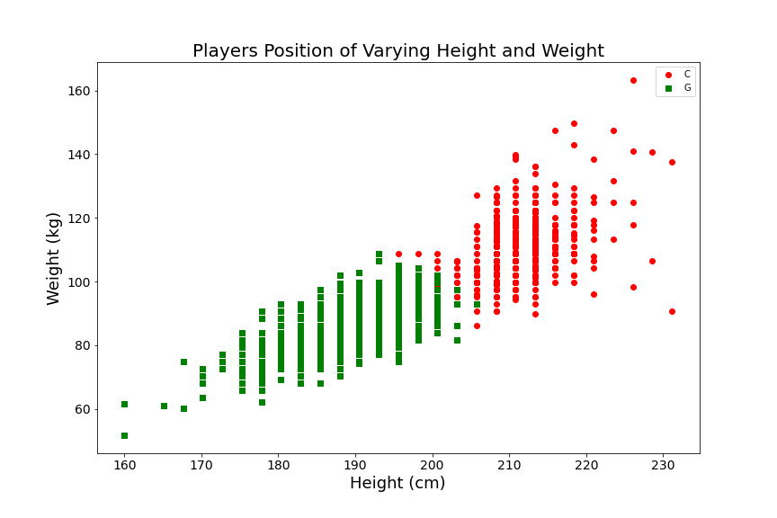
Classification Problem
Predict NBA player positions via height and weight.

Slide 7
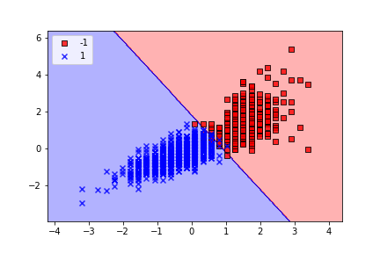
Logistic Regression
>>> lr = LogisticRegression(
C=1.0,
random_state=1,
solver='lbfgs',
multi_class='multinomial'
)
>>> lr.fit(X_train, y_train)
>>> y_test = lr.predict(X_test)
C
G
>>> from sklearn. linear_model import LogisticRegression

Slide 8
Support Vector Machine

Slide 9
Support Vector Machine

Slide 10



Support Vector Machine
Margin
Support vectors
Decision boundary
(Separating hyperplane)
$$ω^{T}x+b=0$$
negative hyperplane
$$ω^{T}x+b=−1$$
positive hyperplane
$$ω^{T}x+b=1$$
Maximize the margin

Slide 11

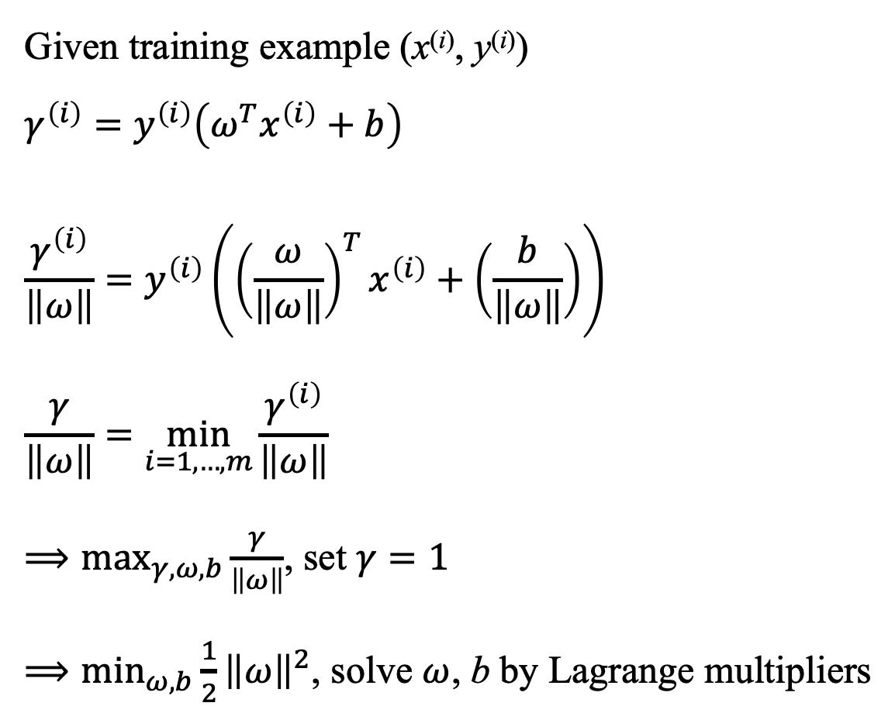
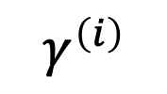

Support Vector Machine
Given training example (x^{(i)}, y^{(i)})
$$γ^{\left(i\right)}=y^{\left(i\right)}\left(ω^{T}x^{\left(i\right)}+b\right)$$
$$\frac{γ^{\left(i\right)}}{\left\|ω\right\|}=y^{\left(i\right)}\left({\left(\frac{ω}{\left\|ω\right\|}\right)}^{T}x^{\left(i\right)}+\left(\frac{b}{\left\|ω\right\|}\right)\right)$$
$$\frac{γ}{\left\|ω\right\|}=\min_{i=1,…,m}{\frac{γ^{\left(i\right)}}{\left\|ω\right\|}}$$
$⟹\max_{γ,ω,b}{\frac{γ}{\left\|ω\right\|}}$, set $γ=1$
$⟹\min_{ω,b}{{\frac{1}{2}\left\|ω\right\|}^{2}}$, solve $ω$, b by Lagrange multipliers
$$ω^{T}x+b=0$$
$$\overset{⃑}{ω}$$
A (x^{(i)}, y^{(i)})
$$γ^{\left(i\right)}$$
B
Notes:
3

Slide 12
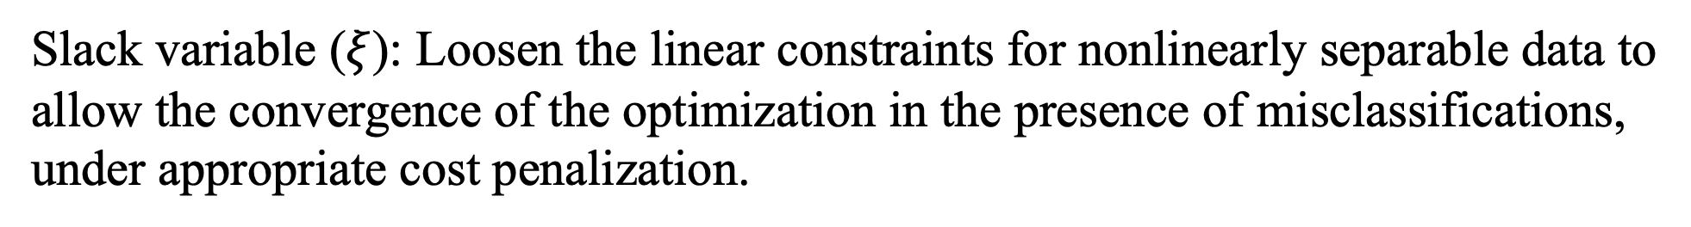
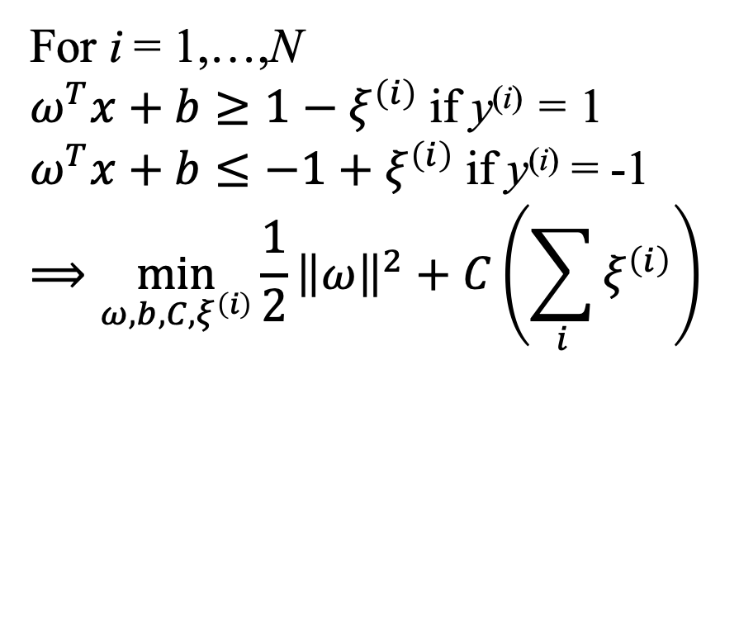
Support Vector Machine
Regularization
Slack variable ($ξ$): Loosen the linear constraints for nonlinearly separable data to allow the convergence of the optimization in the presence of misclassifications, under appropriate cost penalization.
For i = 1,…,N
$ω^{T}x+b≥1−ξ^{\left(i\right)}$ if y^{(i)} = 1
$ω^{T}x+b≤−1+$ $ξ^{\left(i\right)}$ if y^{(i)} = -1
$$⟹\min_{ω,b,C, ξ^{\left(i\right)}}{{\frac{1}{2}\left\|ω\right\|}^{2}}+C\left(\sum_{i}{ξ^{\left(i\right)}}\right)$$
Notes:
3

Slide 13
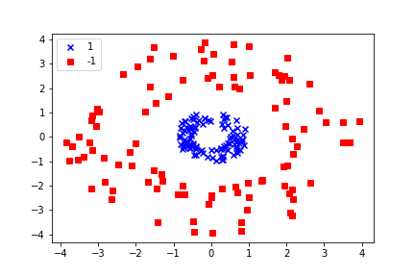
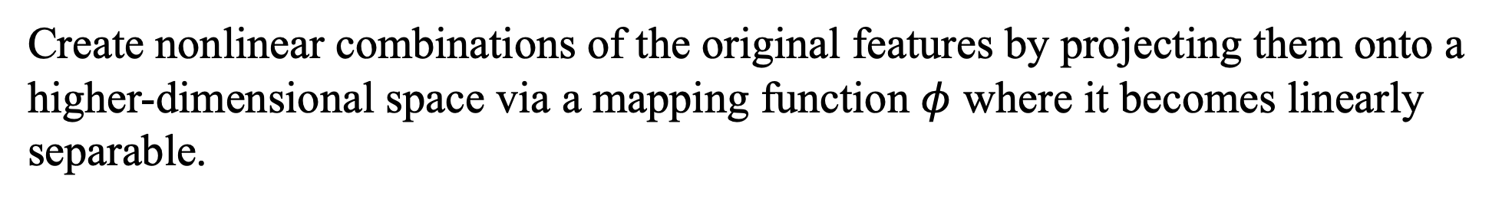
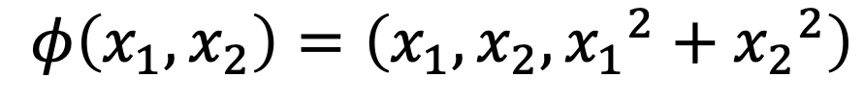
Kernel SVM
Create nonlinear combinations of the original features by projecting them onto a
higher-dimensional space via a mapping function $φ$ where it becomes linearly separable.
$$φ\left(x_{1},x_{2}\right)=\left(x_{1},x_{2},{x_{1}}^{2}+{x_{2}}^{2}\right)$$
x₂
x₁
Notes:
3

Slide 14
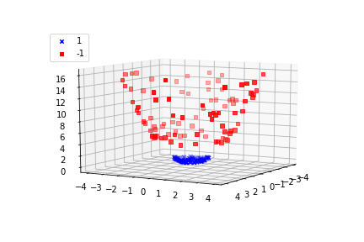
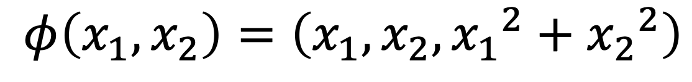
Kernel SVM
$$φ\left(x_{1},x_{2}\right)=\left(x_{1},x_{2},{x_{1}}^{2}+{x_{2}}^{2}\right)$$
x₁² + x₂²
x₁
x₂
Notes:
3

Slide 15



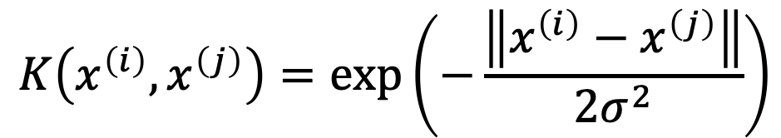
Kernel SVM
Kernel trick: $K\left(x^{\left(i\right)},x^{\left(j\right)}\right)={φ\left(x^{\left(i\right)}\right)}^{T}φ\left(x^{\left(i\right)}\right)$
Linear kernel
$$K\left(x^{\left(i\right)},x^{\left(j\right)}\right)=\left\langle x^{\left(i\right)},x^{\left(j\right)}\right\rangle$$
Polynomial kernel
$$K\left(x^{\left(i\right)},x^{\left(j\right)}\right)={\left(\left\langle x^{\left(i\right)},x^{\left(j\right)}\right\rangle +c\right)}^{d}$$
Gaussian kernel (Radial Basis Function, RBF)
$$K\left(x^{\left(i\right)},x^{\left(j\right)}\right)=\exp\left(−\frac{\left\|x^{\left(i\right)}−x^{\left(j\right)}\right\|}{2σ^{2}}\right)$$
Notes:
3

Slide 16
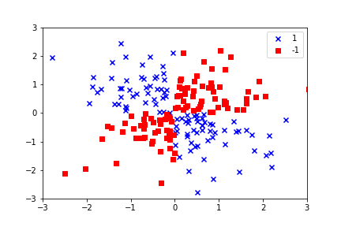
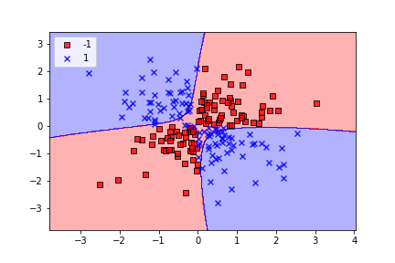
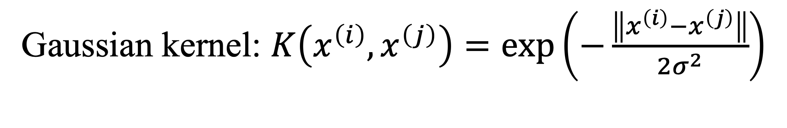
Kernel SVM
Gaussian kernel: $K\left(x^{\left(i\right)},x^{\left(j\right)}\right)=\exp\left(−\frac{\left\|x^{\left(i\right)}−x^{\left(j\right)}\right\|}{2σ^{2}}\right)$
Notes:
3

Slide 17
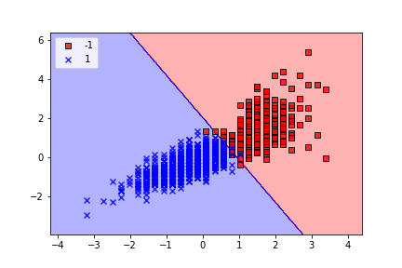
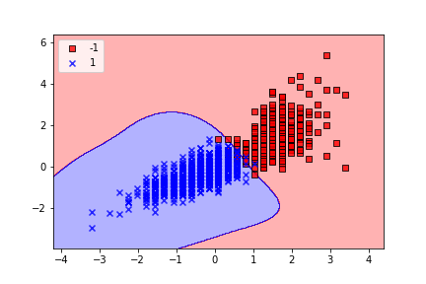
Kernel SVM
Linear kernel
Gaussian kernel
>>> svm_c = SVC(kernel='linear',
random_state=1)
>>> svm_c = SVC(kernel='rbf',
random_state=1)
C
G
C
G
>>> from sklearn.svm import SVC
Notes:
3

Slide 18
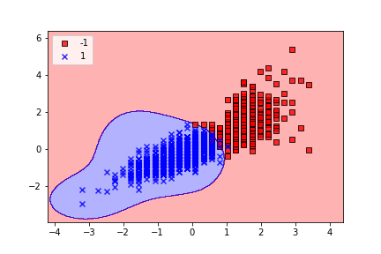
Kernel SVM
Gaussian kernel
>>> svm_c = SVC(kernel='rbf',
random_state=1,
C=1.0)
>>> svm_c = SVC(kernel= 'rbf ',
random_state=1,
C=100.0)
C
G
C
G
Notes:
3

Slide 19
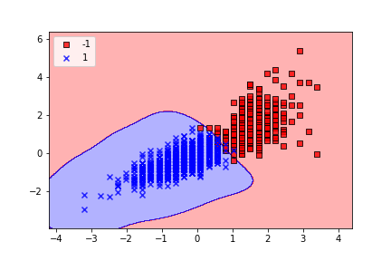
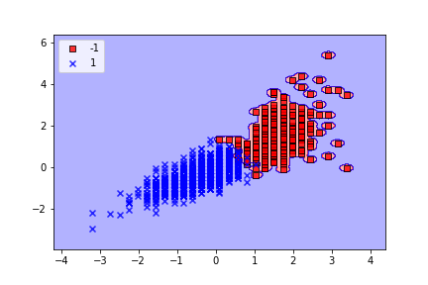
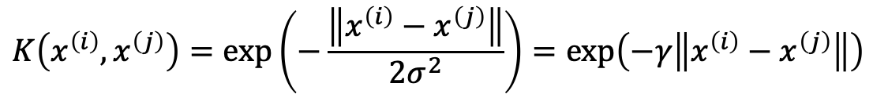
Kernel SVM
Gaussian kernel
$$K\left(x^{\left(i\right)},x^{\left(j\right)}\right)=\exp\left(−\frac{\left\|x^{\left(i\right)}−x^{\left(j\right)}\right\|}{2σ^{2}}\right)=\exp\left(−γ\left\|x^{\left(i\right)}−x^{\left(j\right)}\right\|\right)$$
>>> svm_c = SVC(kernel='rbf',
random_state=1,
gamma=1.0)
>>> svm_c = SVC(kernel= 'rbf ',
random_state=1,
gamma=100.0)
C
G
C
G
Notes:
3

Slide 20
Bias-Variance Trade-off

Slide 21
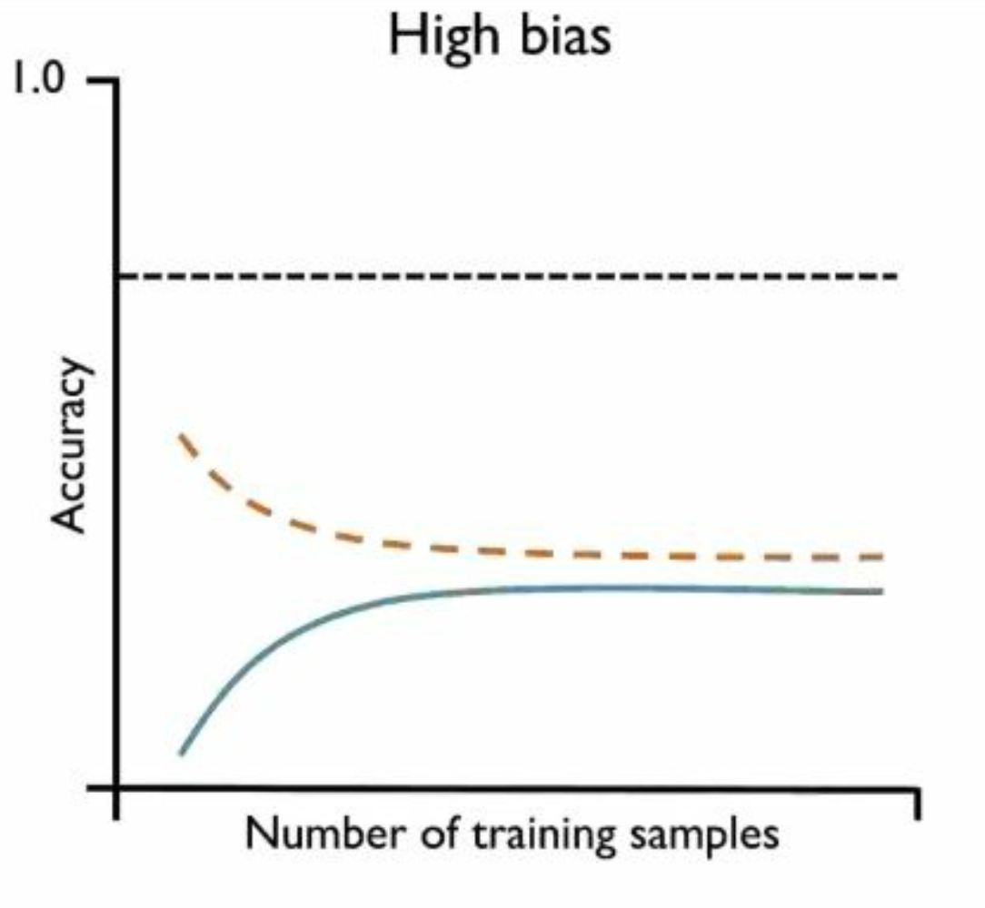
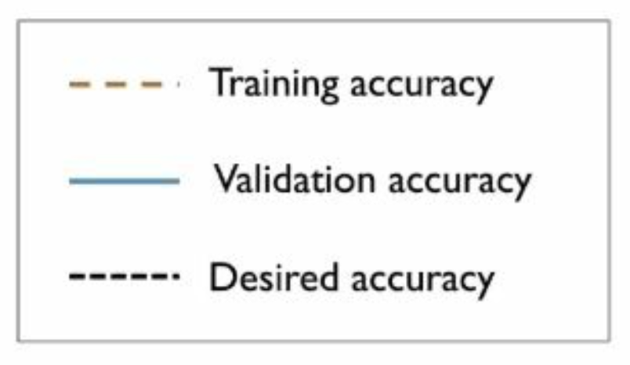
Bias-Variance
High bias

Slide 22
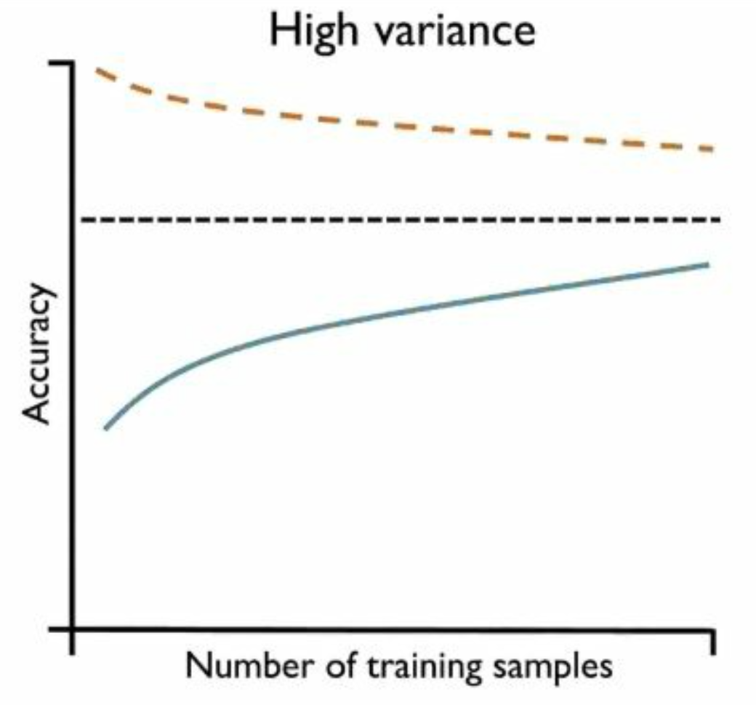

Bias-Variance
High variance

Slide 23
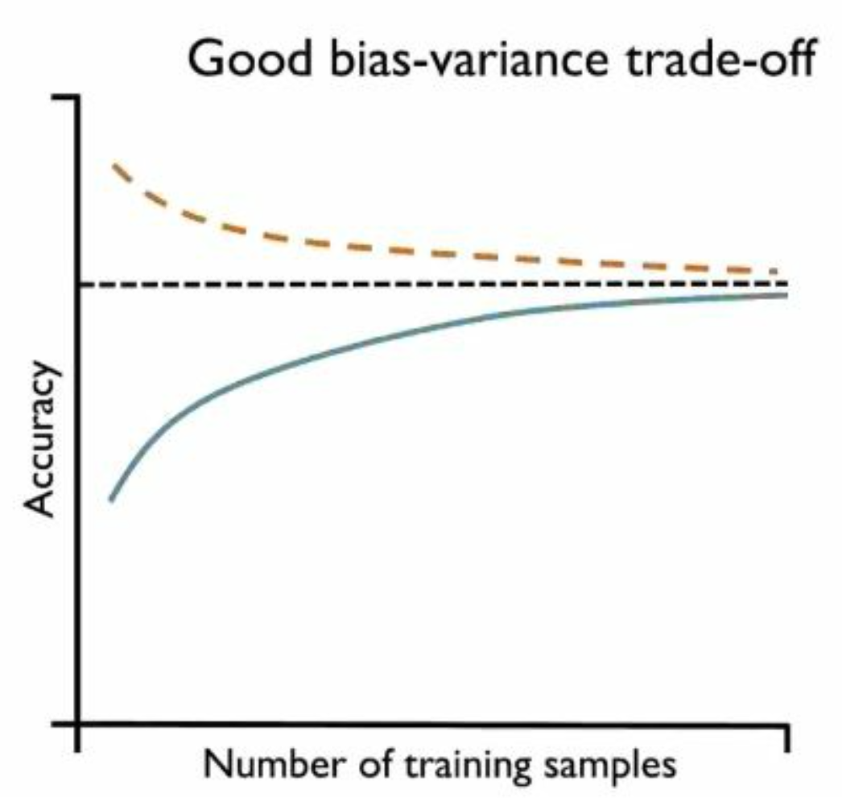
Bias-Variance
Appropriate bias-variance trade-off

Slide 24
Decision Tree

Slide 25
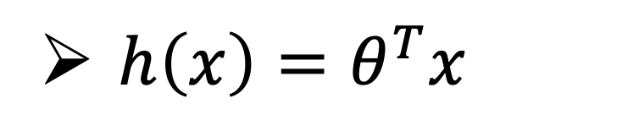
Linear Function
$h\left(x\right)=θ^{T}x$

Slide 26
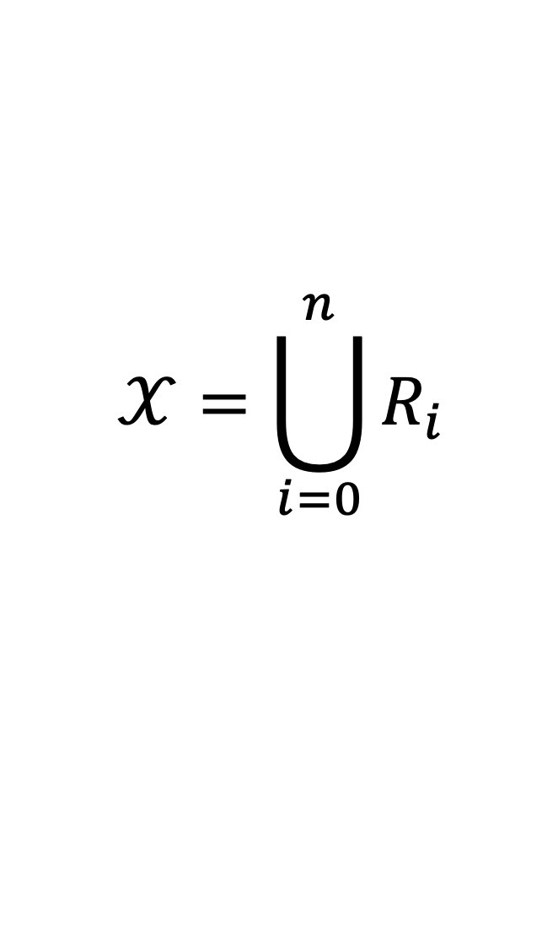
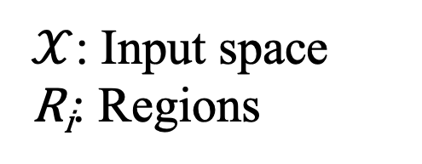
Decision Tree
Non-linear
$$𝒳=\bigcup_{i=0}^{n}{R_{i}}$$
$𝒳$: Input space
R_{i}: Regions

Slide 27
Decision Tree
R₁
Y
N
Height < 201
R₁
R₂
R₂

Slide 28
Decision Tree
Y
N
Height < 201
R₁₁
Y
N
R₂
Weight > 102
R₁₂
R₁₁
R₁₂
R₂

Slide 29
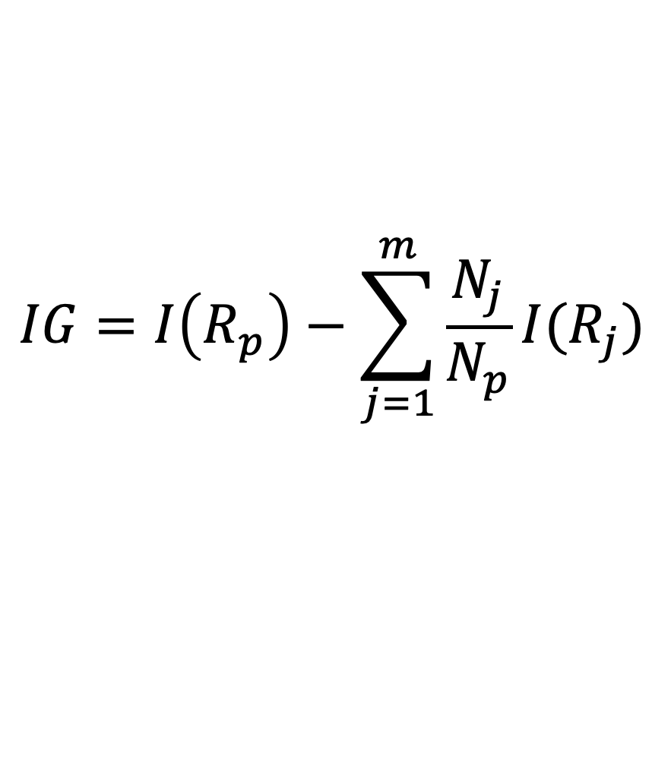

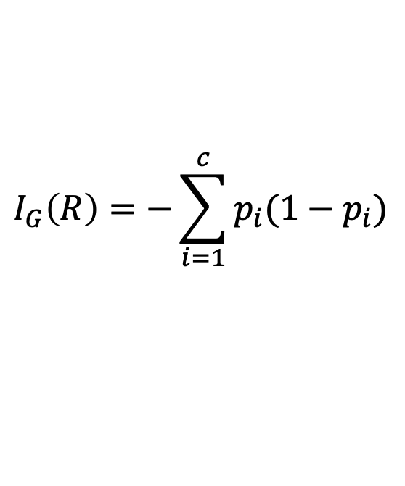
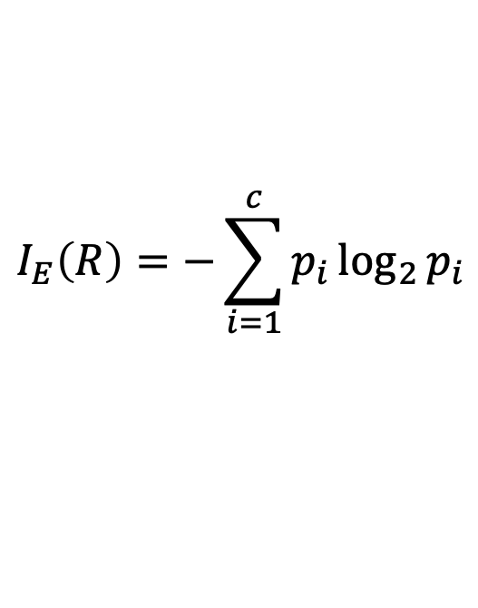
Decision Tree
Information Gain
$$IG=I\left(R_{p}\right)−\sum_{j=1}^{m}{\frac{N_{j}}{N_{p}}I(R_{j})}$$
Classification error
Entropy
Gini impurity
$$I_{E}\left(R\right)=−\sum_{i=1}^{c}{p_{i}\log_{2}{p_{i}}}$$
$$I_{G}\left(R\right)=−\sum_{i=1}^{c}{p_{i}(1−p_{i})}$$
$$I_{C}\left(R\right)=1−\max\left(p_{i}\right)$$

Slide 30


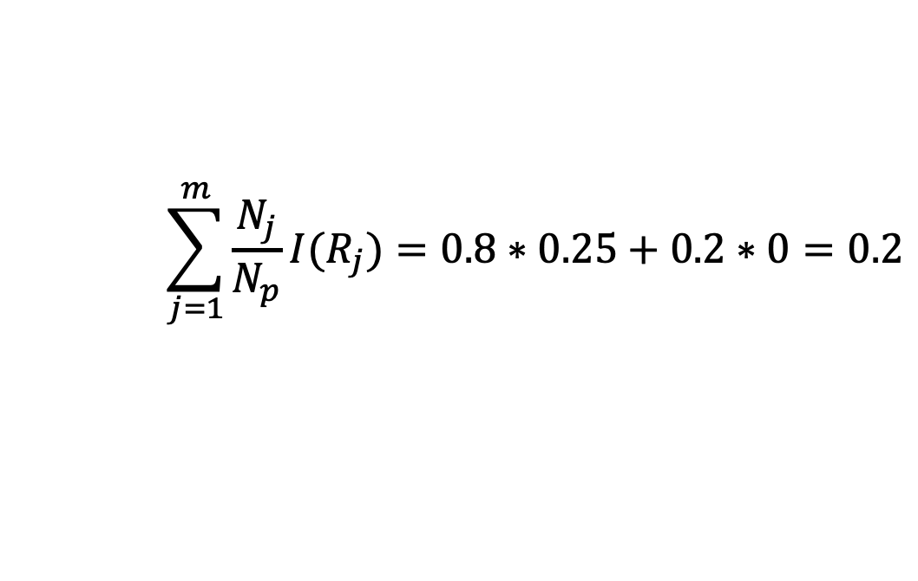
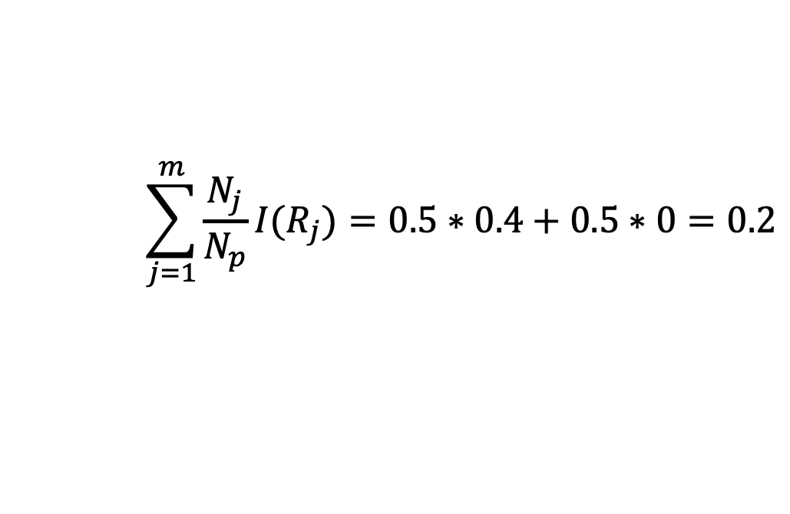
Decision Tree
Classification error
$$I_{C}\left(R\right)=1−\max\left(p_{i}\right)$$
R_{p}: 400 + / 100 -
R_{p}: 400 + / 100 -
$$I\left(R_{p}\right)=1−\max\left(p_{i}\right)=0.2$$
Y
N
Y
N
split
split
p₊: 0.6
p₋: 0.4
p₊: 1
p₋: 0
p₊: 0.75
p₋: 0.25
p₊: 1
p₋: 0
R₁: 150 + / 100 -
R₂: 250 + / 0 -
R₁’: 300 + / 100 -
R₂’: 100 + / 0 -
$$\sum_{j=1}^{m}{\frac{N_{j}}{N_{p}}I(R_{j})}=0.5∗0.4+0.5∗0=0.2$$
$$\sum_{j=1}^{m}{\frac{N_{j}}{N_{p}}I(R_{j})}=0.8∗0.25+0.2∗0=0.2$$

Slide 31
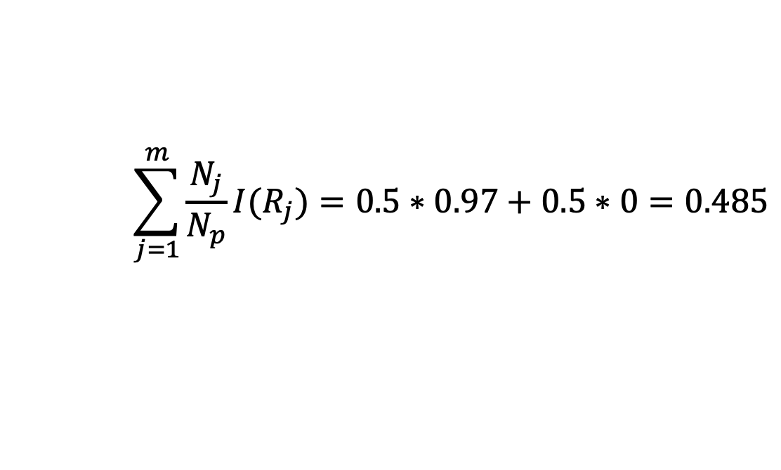

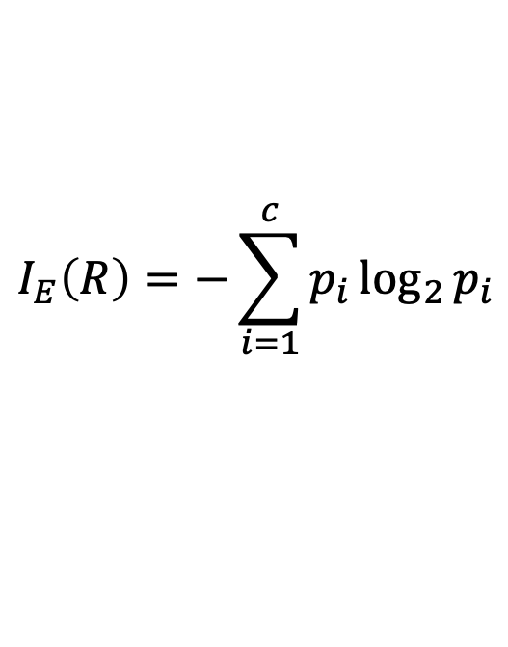
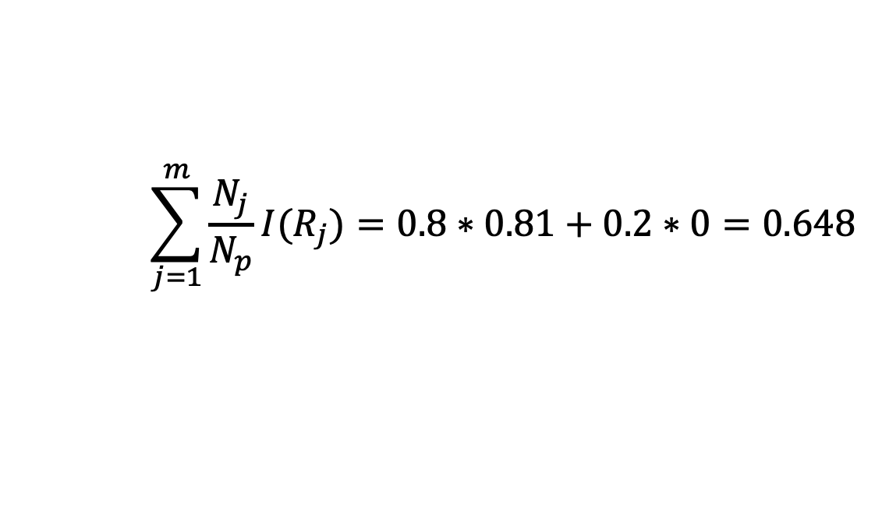
Decision Tree
Entropy
$$I_{E}\left(R\right)=−\sum_{i=1}^{c}{p_{i}\log_{2}{p_{i}}}$$
R_{p}: 400 + / 100 -
R_{p}: 400 + / 100 -
$$I\left(R_{p}\right)=0.72$$
Y
N
Y
N
split
split
p₊: 0.6
p₋: 0.4
p₊: 1
p₋: 0
p₊: 0.75
p₋: 0.25
p₊: 1
p₋: 0
R₁: 150 + / 100 -
R₂: 250 + / 0 -
R₁’: 300 + / 100 -
R₂’: 100 + / 0 -
$$\sum_{j=1}^{m}{\frac{N_{j}}{N_{p}}I(R_{j})}=0.5∗0.97+0.5∗0=0.485$$
$$\sum_{j=1}^{m}{\frac{N_{j}}{N_{p}}I(R_{j})}=0.8∗0.81+0.2∗0=0.648$$

Slide 32
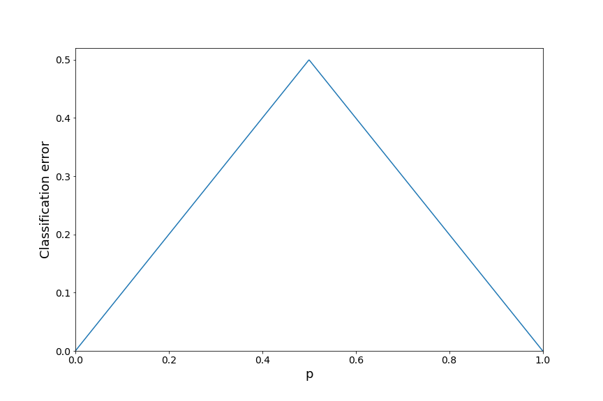
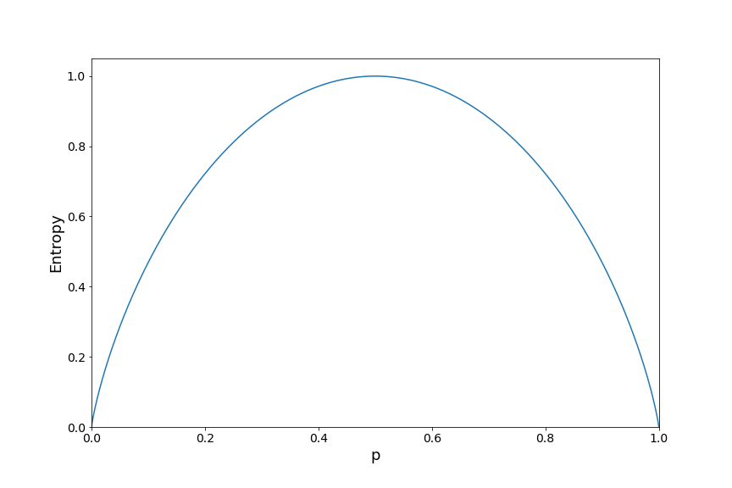

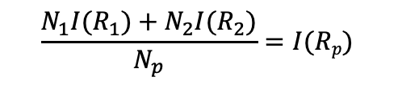





Decision Tree
Classification error
Entropy
$$I(R1)$$
$$I(R_{p})$$
$$I(R1)$$
$$\frac{N_{1}I(R_{1})+N_{2}I(R_{2})}{N_{p}}$$
$$\frac{N_{1}I(R_{1})+N_{2}I(R_{2})}{N_{p}}=I(Rp)$$
$$I(R2)$$
$$I(R2)$$

Slide 33
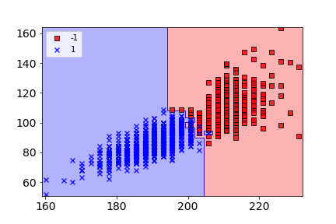
Decision Tree
High variance
C
G
>>> from sklearn.tree import DecisionTreeClassifier

Slide 34
Decision Tree
Regularization
Minimum leaf size – Do not split R if its number of samples falls below a fixed threshold in each of the left and right branches.
Maximum depth – The maximum depth of the tree.
Maximum number of nodes – Stop if a tree has more than a fixed threshold of leaf nodes.

Slide 35
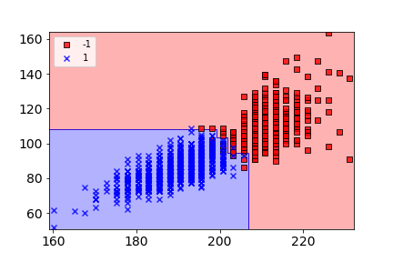
Decision Tree
>>> tree = DecisionTreeClassifier(
criterion='entropy', random_state=1
)
>>> tree = DecisionTreeClassifier(
criterion='entropy', random_state=1,
min_samples_split=10,
max_depth=4,
max_leaf_nodes=20
)
C
G
C
G
>>> from sklearn.tree import DecisionTreeClassifier

Slide 36
Decision Tree
Interpretable
C
G
>>> tree.feature_importances_
Height: 0.94667332
Weight: 0.05332668

Slide 37
Ensemble

Slide 38
Ensemble
Combine different classifiers into a metaclassifier that has better generalization performance than each individual classifier alone.
Using different algorithms
Using different training sets
Bagging
Boosting

Slide 39
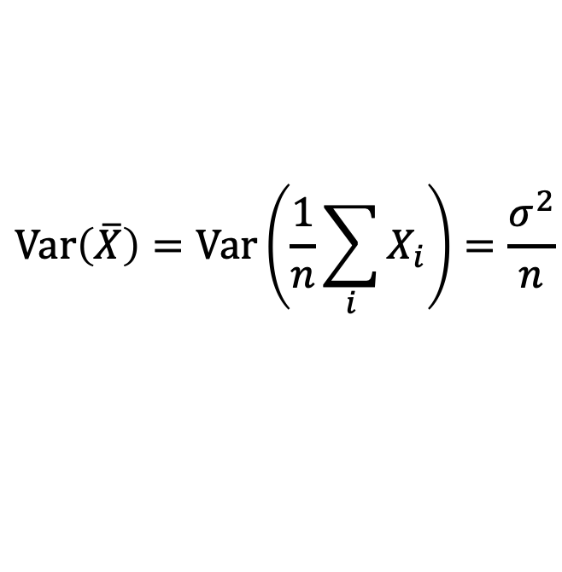
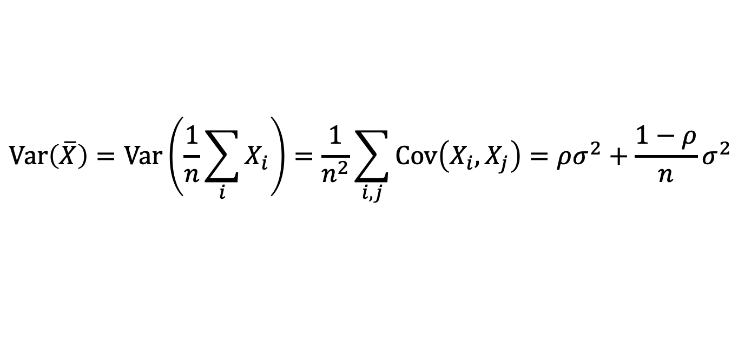

Ensemble
=> For all variables X_{i}
$$\operatorname{Var}\left(X_{i}\right)=σ^{2}$$
=> For n independent, identically distributed (i.i.d.) random variables X_{i}
$$\operatorname{Var}\left(\overline{X}\right)=\operatorname{Var}\left(\frac{1}{n}\sum_{i}{X_{i}}\right)=\frac{σ^{2}}{n}$$
=> For n identically distributed (i.d.) random variables X_{i}
$$\operatorname{Var}\left(\overline{X}\right)=\operatorname{Var}\left(\frac{1}{n}\sum_{i}{X_{i}}\right)=\frac{1}{n^{2}}\sum_{i, j}{\operatorname{Cov}\left(X_{i}, X_{j}\right)}=ρσ^{2}+\frac{1−ρ}{n}σ^{2}$$
where $ρ$ is correlation factor of variables X_{i}

Slide 40
Ensemble
Bagging
Bagging is also known as “Bootstrap Aggregation” and is a variance reduction ensembling method.
Model 1
N₁
Model 2
Average / Voting
N₂
N
Model 3
N₃

Slide 41





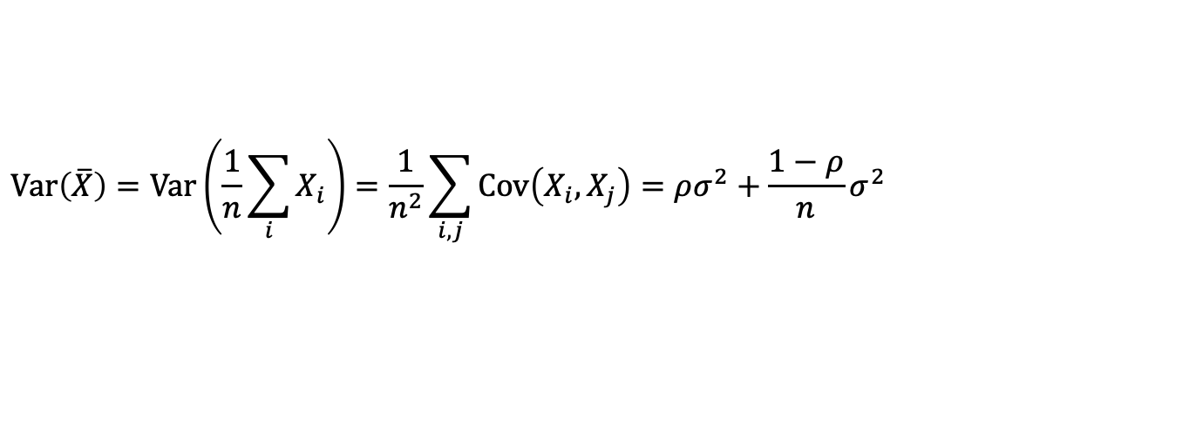
Random Forest
Decision tree
Fully-grown decision trees are high variance, low bias models.
Bagging + Decision tree
=> Random Forest
A subset of features are only allowed to be used at each split.
$$\operatorname{Var}\left(\overline{X}\right)=\operatorname{Var}\left(\frac{1}{n}\sum_{i}{X_{i}}\right)=\frac{1}{n^{2}}\sum_{i, j}{\operatorname{Cov}\left(X_{i}, X_{j}\right)}=ρσ^{2}+\frac{1−ρ}{n}σ^{2}$$

Slide 42

Random Forest
>>> forest = RandomForestClassifier(
criterion='gini',
n_estimators=25,
random_state=1,
n_jobs=2,
min_samples_split=10, max_depth=4,
max_leaf_nodes=20
)
C
G
Height: 0.66658916
Weight: 0.33341084
>>> from sklearn.ensemble import RandomForestClassifier

Slide 43
Random Forest
Decision tree
Random forest

Slide 44
Ensemble
Boosting
Boosting is a bias reduction ensembling method in contrast to bagging which reduces variance.
M₁
M₂
M₃

Slide 45
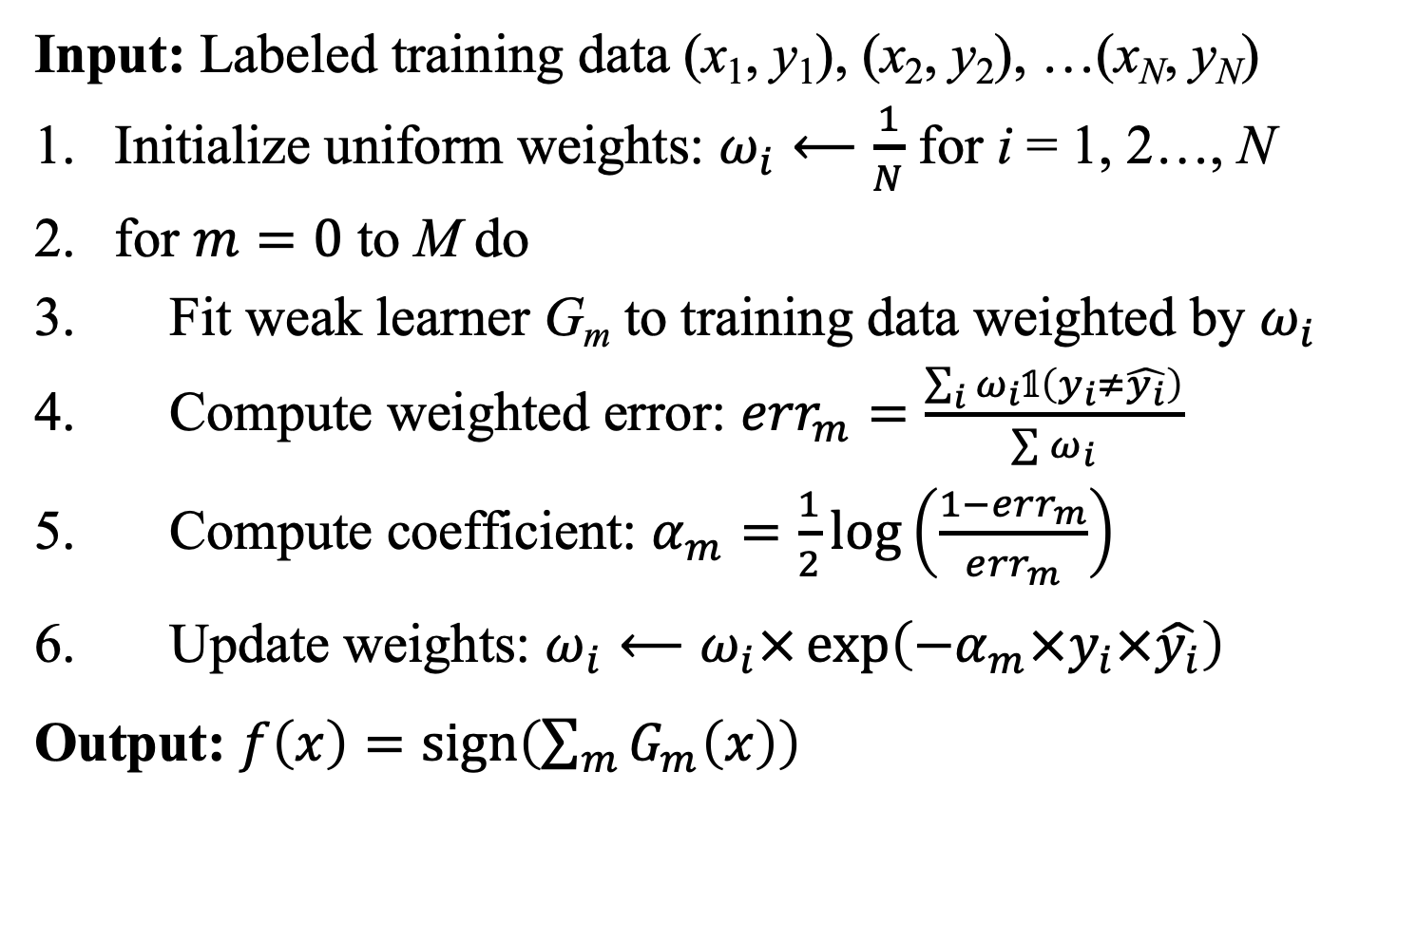
Adaboost
Algorithm
Input: Labeled training data (x₁, y₁), (x₂, y₂), …(x_{N}, y_{N})
Initialize uniform weights: $ω_{i}⟵\frac{1}{N}$ for i = 1, 2…, N
for $m=0$ to M do
Fit weak learner G_{m} to training data weighted by $ω_{i}$
Compute weighted error: ${err}_{m}=\frac{\sum_{i}{ω_{i}𝟙\left(y_{i}≠\hat{y_{i}}\right)}}{\sum{ω_{i}}}$
Compute coefficient: $α_{m}=\frac{1}{2}\log\left(\frac{1−{err}_{m}}{{err}_{m}}\right)$
Update weights: $ω_{i}⟵ω_{i}×\exp\left({−α}_{m}×y_{i}×\hat{y_{i}}\right)$
Output: $f\left(x\right)=\operatorname{sign}\left(\sum_{m}{G_{m}\left(x\right)}\right)$

Slide 46

Adaboost
Decision tree stumps
C
G

Slide 47

Adaboost
C
G
>>> ada = AdaBoostClassifier(
base_estimator=tree,
n_estimators=25,
random_state=1
)
>>> from sklearn.ensemble import AdaBoostClassifier

Slide 48

Forward Stagewise Boosting
Algorithm
Input: Labeled training data (x₁, y₁), (x₂, y₂), …(x_{N}, y_{N})
Initialize f₀(x) = 0
for $m=0$ to M do
Compute $\left(β_{m},γ_{m}\right)=\underset{α}{argmin}{\sum_{i=1}^{N}{L\left(y_{i},f_{m−1}\left(x_{i}\right)+βG\left(x_{i},γ\right)\right)}}$
Set $f_{m}\left(x\right)=f_{m−1}\left(x\right)+β_{m}G\left(x,γ_{m}\right)$
Output: $f\left(x\right)=f_{m}\left(x\right)$

Slide 49


Gradient Boosting
Forward stagewise boosting
Input: Labeled training data (x₁, y₁), (x₂, y₂), …(x_{N}, y_{N})
Initialize f₀(x) = 0
for $m=0$ to M do
Compute $\left(β_{m},γ_{m}\right)=\underset{α}{argmin}{\sum_{i=1}^{N}{L\left(y_{i},f_{m−1}\left(x_{i}\right)+βG\left(x_{i},γ\right)\right)}}$
Set $f_{m}\left(x\right)=f_{m−1}\left(x\right)+β_{m}G\left(x,γ_{m}\right)$
Output: $f\left(x\right)=f_{m}\left(x\right)$
Gradient boosting
$g_{m}=\frac{∂L\left(y,f\left(x_{i}\right)\right)}{∂f\left(x_{i}\right)}$
$γ_{i}=\underset{γ}{argmin}{\sum_{i=1}^{N}{{\left(g_{m}−G\left(x_{i},γ\right)\right)}^{2}}}$

Slide 50
Other boosting methods
\LightGBM
XGBoost
CatBoost
NGBoost

Slide 51
Thank you

